Slide 1

SIG JS Tooling
08-08-2019

Slide 2
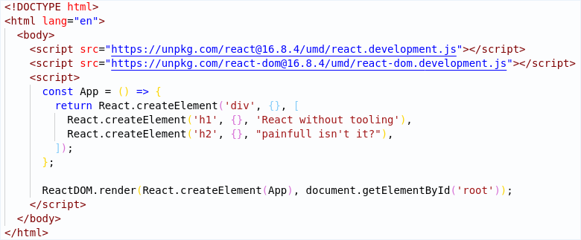
What would life be like without tooling?
JS Tooling
1

Slide 3
What is Tooling
Tooling is the catch-all term for libraries, scripts, frameworks, packages, etc which make your life as a developer easier
JS Tooling
1

Slide 4













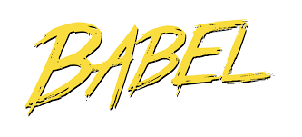

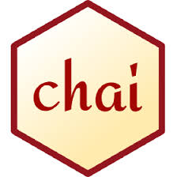




Linters
Types of Tooling
Runners
Bundlers
Transpilers
Testing frameworks
JS Tooling
1

Slide 5
Task Runners
Orchestration of other tools
Achieved through plugins
Problematic in maintenance
Runners are not used in modern js. NPM scripts are used instead.
JS Tooling
<number>

Slide 6

NPM
Dependencies
Scripts
Config
Project information
JS Tooling
<number>

Slide 7
Bundlers
Bundling
Code splitting
Hot reload
minification
JS Tooling
<number>

Slide 8
Bundlers
Very flexible
Production quality builds
JS only out of the box
HMR with plugin
Standard output to ES2015
Excellent dead code elimination
JS only out of the box
No HMR
Easier config than webpack
Faster than webpack
No config
Very fast
Support various filetypes out of the box
HMR out of the box
JS Tooling
<number>

Slide 9
Transpilers
JS Tooling
<number>

Slide 10
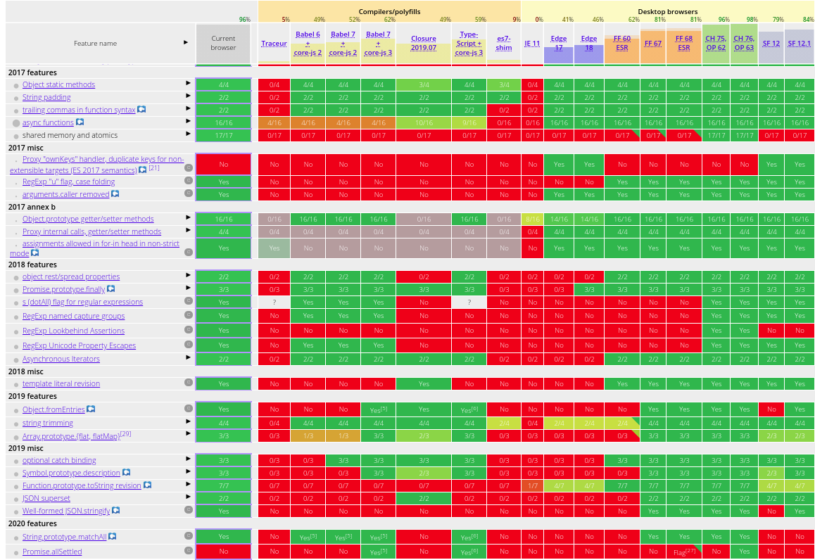
ES2016+
JS Tooling
<number>

Slide 11
Linters
JS Tooling
<number>

Slide 12
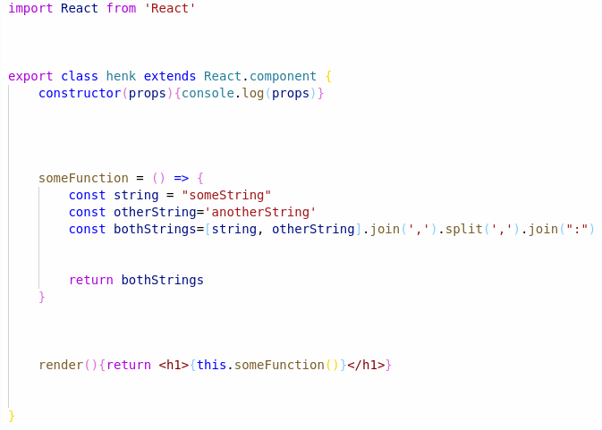
Prettier & Editorconfig
JS Tooling
<number>

Slide 13
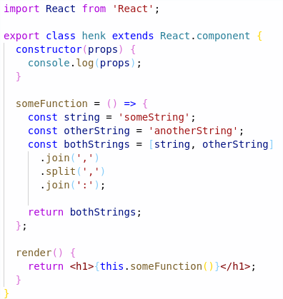
Prettier & Editorconfig
JS Tooling
<number>

Slide 14
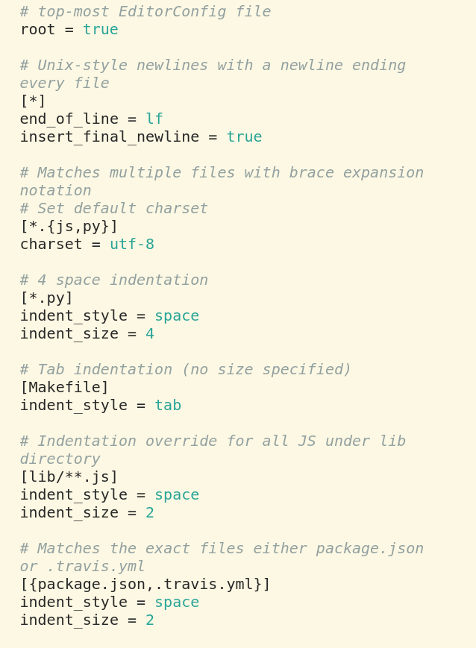
Prettier & Editorconfig
JS Tooling
<number>

Slide 15
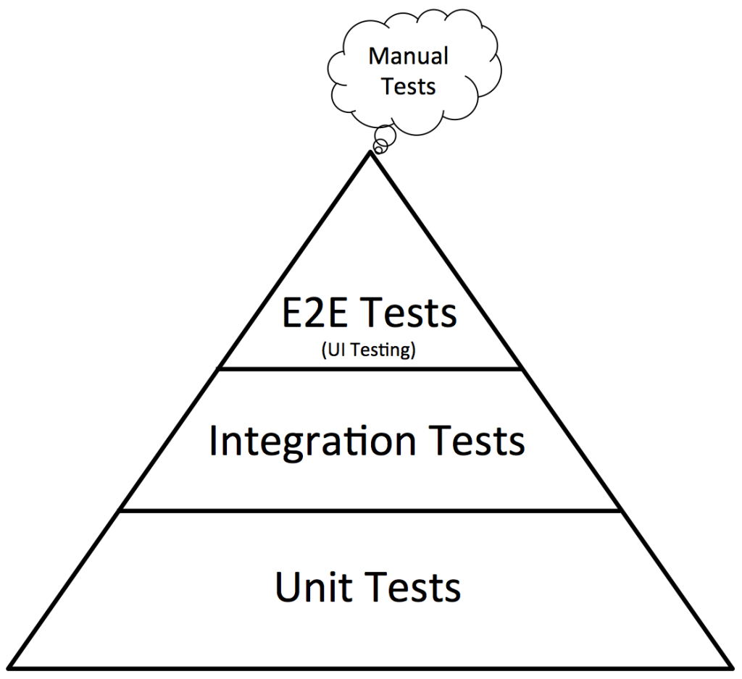
Testing
JS Tooling
<number>

Slide 16


Testing
JS Tooling
<number>

Slide 17
Testing
JS Tooling
<number>

Slide 18
Testing
Testing structure (Mocha, Jasmine, Jest)
Asserters (Chai, Jasmine, Jest)
Runner (Mocha, Jasmine, Jest, Karma)
Mocks/Spies/Stubs (Sinon, Jasmine, Enzyme, Jest)
Code Coverage (Istanbul, Jest, Blanket)
Flexible
Fast
Easy setup
JS Tooling
<number>

Slide 19

Dinner & Hands On
It’s dinnertime!
React
<number>

